Slide 1
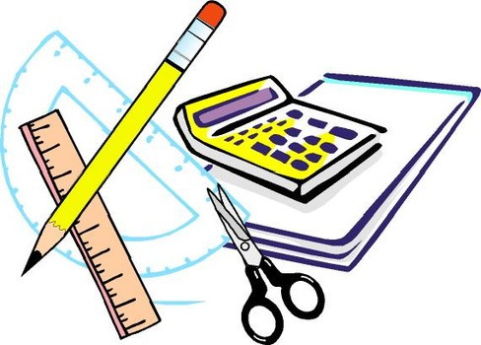
Learning Objective
I will use the distributive law and identify the associative and commutative laws
Enter quietly, please be ready with the following on your desk:
Whiteboard
Whiteboard marker
Exercise Book
Pencil, pen, ruler and red pen
Diary
Calculator
Device – charged or borrowed from Library before maths

Slide 2
Daily Review
CFU 1
What do we know about 14+3 and 3+14?
The order in which you add or multiply two numbers, does not change the results
CFU 2
What do we know about 6+8 and 8+6?
18 + 2 = 20
CFU 3
What is this law called?
2 + 18 = 20
This is called the commutative law

Slide 3
Daily Review
CFU 1
What do we know about 4x7 and 7x4?
The order in which you add or multiply two numbers, does not change the results
CFU 2
What do we know about 3x8 and 8x3?
4 x 7 = 28
CFU 3
What is this law called?
7 x 4 = 28
CFU 4
What does this law state?
This is called the commutative law

Slide 4
Daily Review
CFU 1
What do we know about 4x10 and 10x4?
The order in which you add or multiply two numbers, does not change the results
CFU 2
What do we know about 10x8 and 8x10?
10 x 7 = 70
CFU 3
What is this law called?
7 x 10 = 70
CFU 4
What does this law state?
This is called the commutative law

Slide 5
Daily Review
CFU 1
What do we know about (4x10) x 2 and 4x(10 x 2)?
The order in which three or more numbers are added or multiplied, does not change the results
CFU 2
What do we know about (10x2)x4 and 10x(2x4)?
3 x 7 x 2 = 42
CFU 3
What is this law called?
3 x 2 x 7 = 42
CFU 4
What does this law state?
This is called the associative law

Slide 6
Daily Review
CFU 1
What do we know about (4x5) x 2 and 4x(5 x 2)?
The order in which three or more numbers are added or multiplied, does not change the results
CFU 2
What do we know about (3x2)x4 and 3x(2x4)?
5 x 2 x 3 = 30
CFU 3
What is this law called?
2 x 3 x 5 = 30
CFU 4
What does this law state?
This is called the associative law

Slide 7
Daily Review
CFU 1
Why did we place the 7 and 13 together?
We will now add using the ‘make easy numbers’ strategy
7 + 32 + 13
= 7 + 13 + 32 (swap the 32 and the 13)
= 20 + 32
= 52

Slide 8
Daily Review
CFU 1
Why did we place the 5 and 5 together?
We will now add using the ‘make easy numbers’ strategy
5 + 32 + 5
= 5 + 5 + 32 (swap the 32 and the 5)
= 10 + 32
= 42

Slide 9
Mixed Practice
Whiteboards
8 + 22 + 34
3 + 45 + 27

Slide 10
Daily Review
CFU 1
Why did we swap the 13 and 5?
We will now add using the ‘make easy numbers’ strategy
2 x 13 x 5
= 2 x 5 x 13 (swap 13 and 5)
= 10 x 13
= 130

Slide 11
Daily Review
CFU 1
Why did we swap the 9 and 5?
We will now add using the ‘make easy numbers’ strategy
2 x 9 x 5
= 2 x 5 x 9 (swap 9 and 5)
= 10 x 9
= 90

Slide 12
Mixed Practice
Whiteboards
4 x 30 x 5
2 x 33 x 5

Slide 13

Learning Objective
CFU
What will we learn today?
I will use the distributive law and identify the associative and commutative laws
CFU
How will you know that you are successful?
Success Criteria
At the end of the lesson, I will be able to:
Use the distributive law to calculate
identify which of the associative, commutative and distributive laws are being applied

Slide 14

Concept Development
CFU 1
What is the distributive law
Distributive law – we split large numbers into 1s, 10s and 100s
CFU 2
What does the distributive law involve?
7 x 16
7 is a small number so we leave it as it is
16 is a large number so we split it into 10 + 6

Slide 15
Skill Development
CFU 1
What is the distributive law
Distributive law – we split large numbers into 1s, 10s and 100s
CFU 2
What does the distributive law involve?
8 x 18
8 is a small number so we leave it as it is
18 is a large number so we split it into 10 + 8

Slide 16
Skill Development
CFU 1
What is the distributive law
Distributive law – we split large numbers into 1s, 10s and 100s
CFU 2
What does the distributive law involve?
7 x 22
7 is a small number so we leave it as it is
22 is a large number so we split it into 20 + 2

Slide 17
Concept Development
Distributive law – we split large numbers into 1s, 10s and 100s
2 x 13
2 is a small number so we leave it as it is
13 is a large number so we split it into 10 + 3
2 x (10 + 3)
2x10 + 2x3
20 + 6
26

Slide 18
Concept Development
Whiteboards
15 x 9
9 x (10 + 5)

Slide 19
Guided Practice
Whiteboards
6 x 43

Slide 20
Guided Practice
Whiteboards
37 x 6
57 x 8
78 x 4

Slide 21
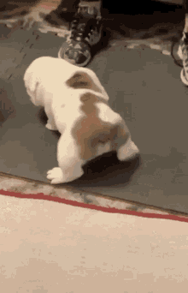
Guided Practice
15 x 13
13 is the smaller number so we leave it as it is
Whiteboards
13 x (10 + 5)
13x10 + 13x5
130 + 65
195

Slide 22
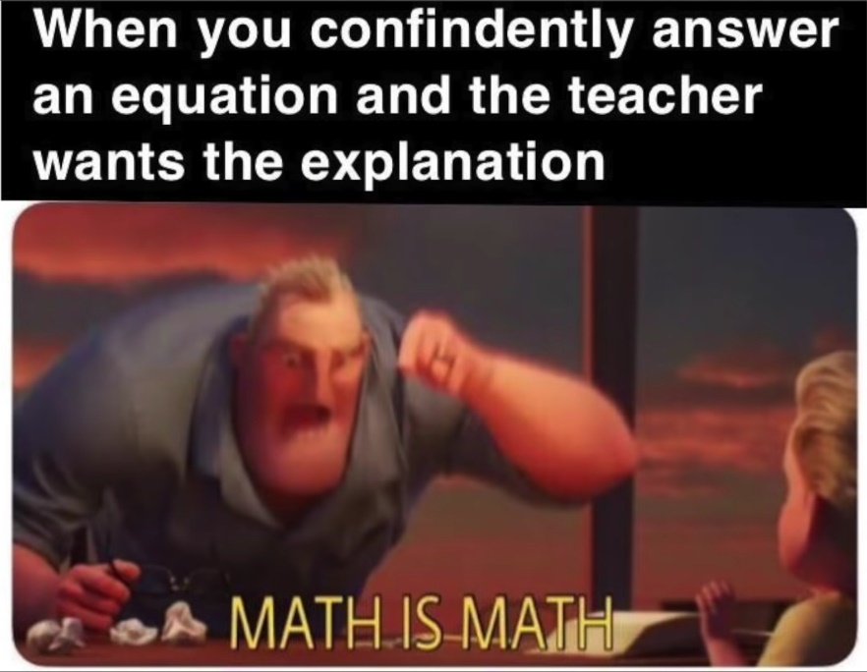
Skill Closure
What have we learnt today?
Lesson Objectives:
I will use the distributive law and identify the associative and commutative laws
2 x 33
2 is a small number so we leave it as it is
33 is a large number so we split it into 30 + 3
2 x (30 + 3)
2x30 + 2x3
60 + 6
66

Slide 23


Independent Practice
Mathematics Page Layout
Open your textbooks to:
Chapter 1.1
Questions: 2, 3, 4, 5

